Slide 1

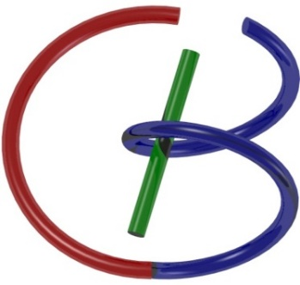
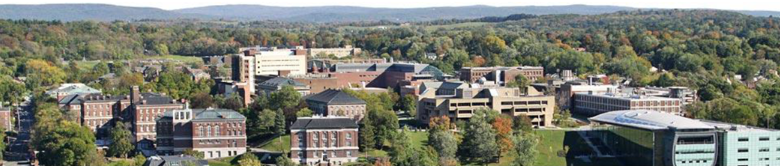
Optical Imaging
Ge Wang
AI-based X-ray Imaging System (AXIS) Lab
Rensselaer Polytechnic Institute, Troy, New York, USA
November 16, 2021

Slide 2
MI Schedule for F21
Tue | Topic | Fri | Topic
08/31 | Introduction | 09/03 | Neuron, Network & Backpropagation
09/07 | No Class | 09/10 | Hands-on 1: Python, Colab, & TensorF
09/14 | Architectures & Training | 09/19 | Hands-on 2: MNIST Classification
09/21 | Image Quality I | 09/24 | CT Physics
09/28 | CT Reconstruction | 10/01 | Deep CT Reconstruction
10/05 | Hands-on 3: CT Networks | 10/08 | More CT Contents
10/12 | MRI Physics | 10/15 | Spin-Echo
10/19 | K-Space Theorem | 10/22 | More MRI Contents
10/26 | Mid Exam | 10/29 | Deep MRI Reconstruction
11/02 | Hands-on 4: MRI Networks | 11/05 | Nuclear Physics
11/09 | Nuclear Imaging | 11/12 | US Imaging
11/16 | Optical Imaging | 11/19 | Multimodality Imaging
11/23 | Hands-on 5: Image Conversion | 11/26 | Thanksgiving
11/30 | Image Quality II | 12/03 | Stability, Interpretability, & Others
12/07 | Overview | 12/10 | Final Exam
Office Hour: Teaching Day 5-6pm: https://rensselaer.webex.com/meet/wangg6

Slide 3
Outline
Optical Coherent Tomography (OCT)
– Basic Idea
– Further Analysis
– OCT System & Applications
Radiative Transfer Equation (RTE)
– Key Definitions
– Derivation
– Monte-Carlo Simulation
– Diffusive Imaging

Slide 4
Optical Coherence Tomography (OCT)
Standard Clinical
Scanners
Resolution (log)
1mm
Ultrasound
100µm
10µm
OCT
1µm
Confocal
Penetration Depth (log)
1mm
1cm
10cm

Slide 5
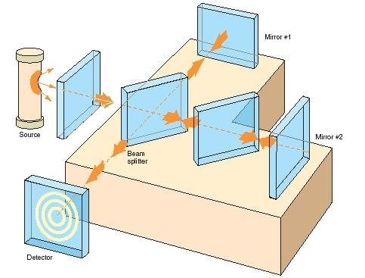
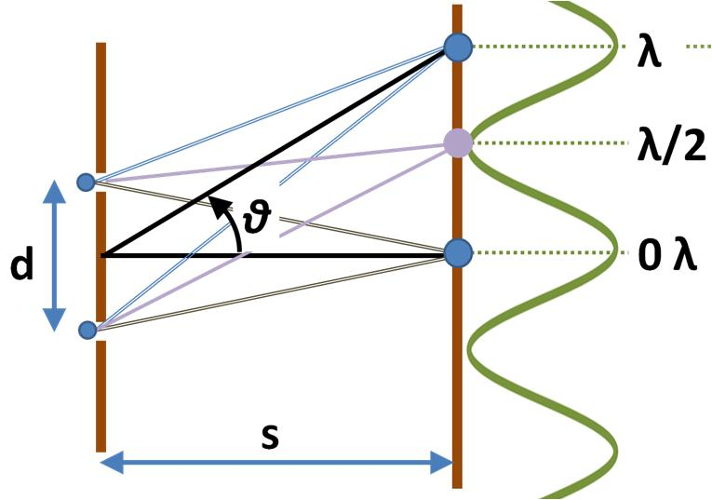
Double Slit Experiment & Interferometer

Slide 6
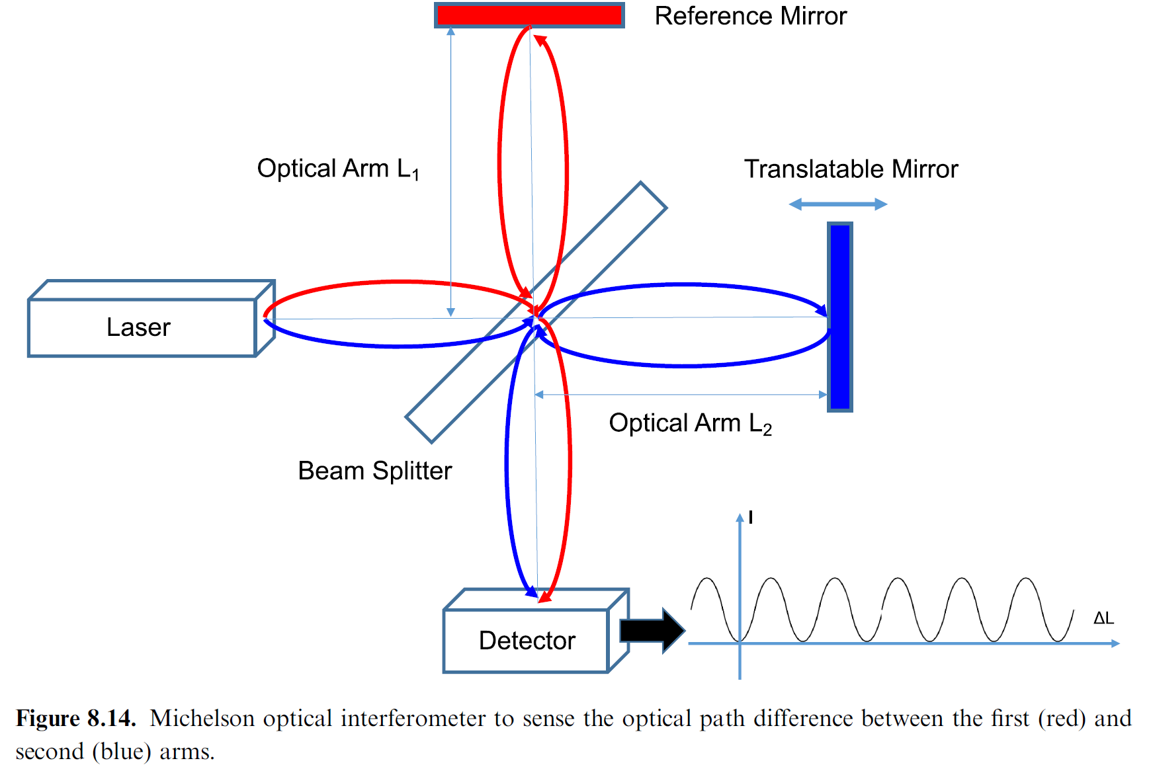
Small Offset, Big Power Change

Slide 7
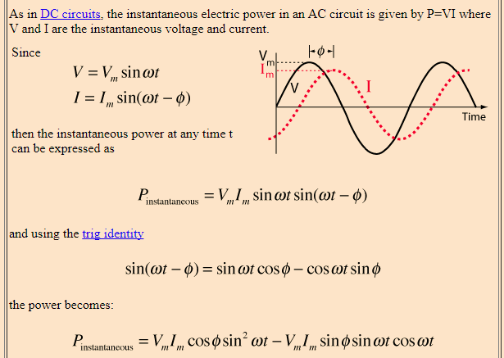
Instantaneous Power

Slide 8
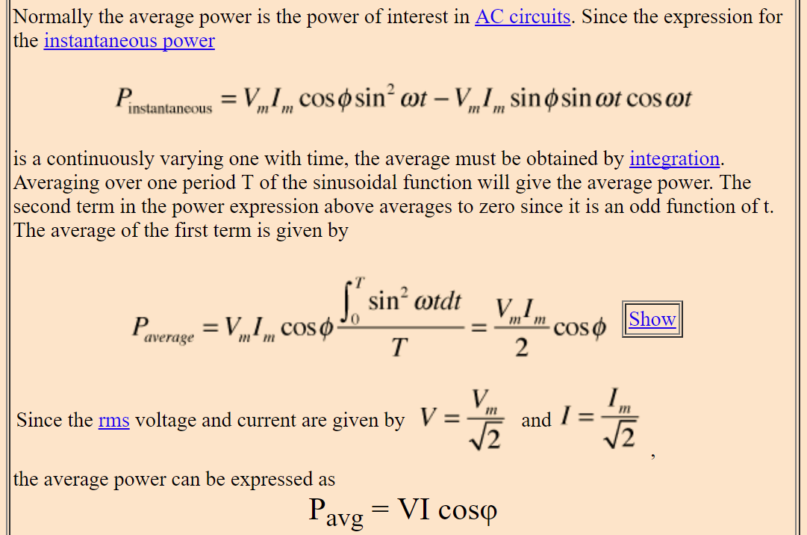
Average Power

Slide 9
Interference Intensity (Power/Area)
Note (I denotes Intensity here)
Intensity: power per unit area
Power: energy per unit time

Slide 10
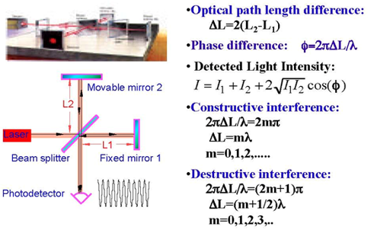
Michelson Interferometer

Slide 11
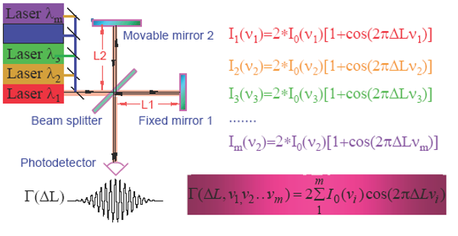
Pattern with Partially Coherent Light

Slide 12
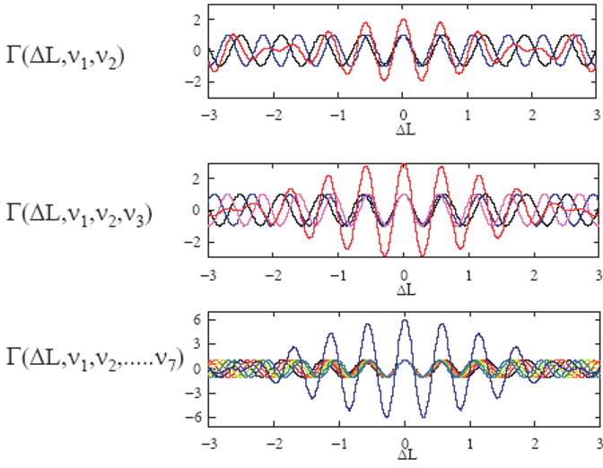
Examples with Partial Coherence

Slide 13
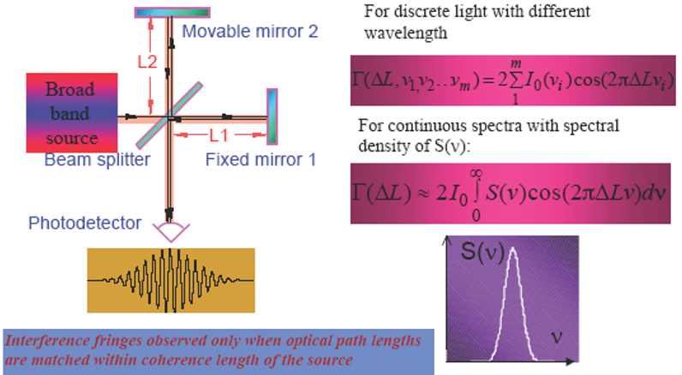
In the Limiting Case

Slide 14
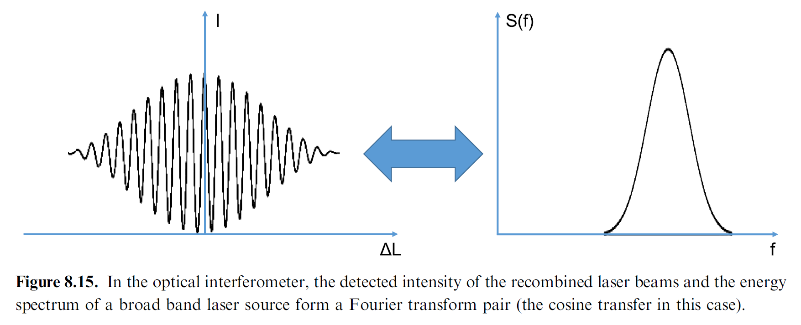
Fourier Transform Pair

Slide 15
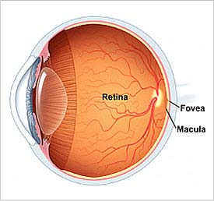
OCT - Optical Analog of US

Slide 16



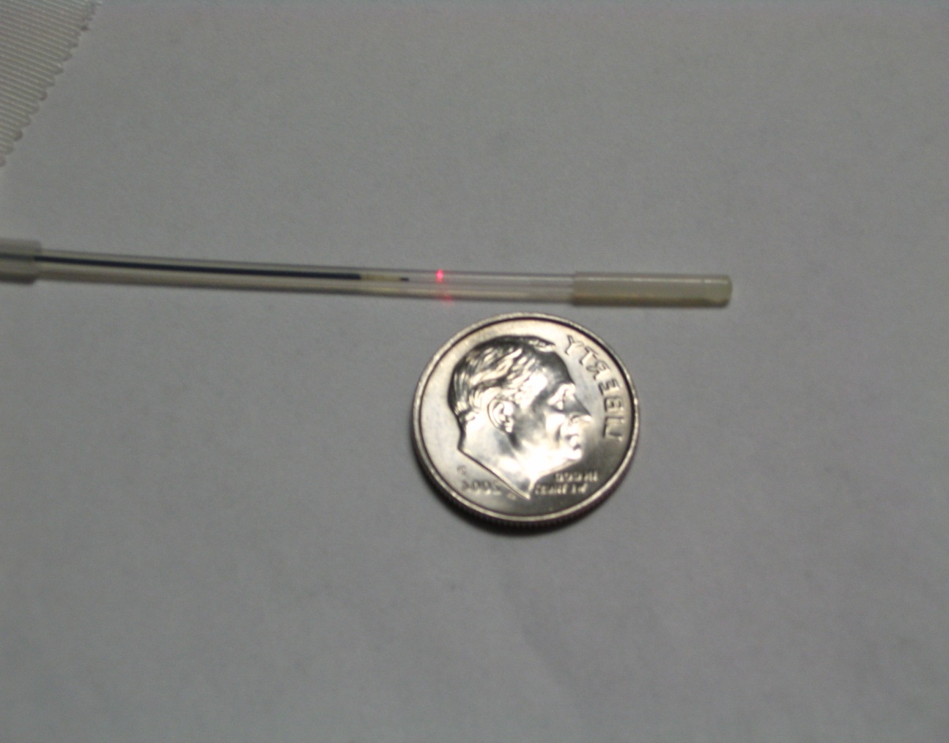


Catheter-based OCT
Distal Interface
Rotary Design
lens
rotary fiber
lens
catheter sheath
stationary
Proximal
Actuation
stationary
fiber
fiber
Motor
Motor
Push-Pull Design
connector
fiber
connector
fiber
fiber
catheter sheath
Courtesy of Dr. Yu Chen & LightLab Imaging, Inc.

Slide 17
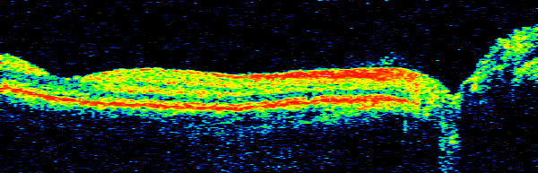
Optical Biopsy
Vitreous
NFL
Optic Disc
Ophthalmology
Cardiology
Gastroenterology
Developmental Biology
F
o
v
ea
Photoreceptors
Chor
iocapillar
is
250 µm
250 µm
Log Reflection
Hee et al. 1995

Slide 18
Outline
Optical Coherent Tomography (OCT)
– Basic Idea
– Further Analysis
– OCT System & Applications
Radiative Transfer Equation (RTE)
– Key Definitions
– Derivation
– Monte-Carlo Simulation
– Diffusive Imaging

Slide 19
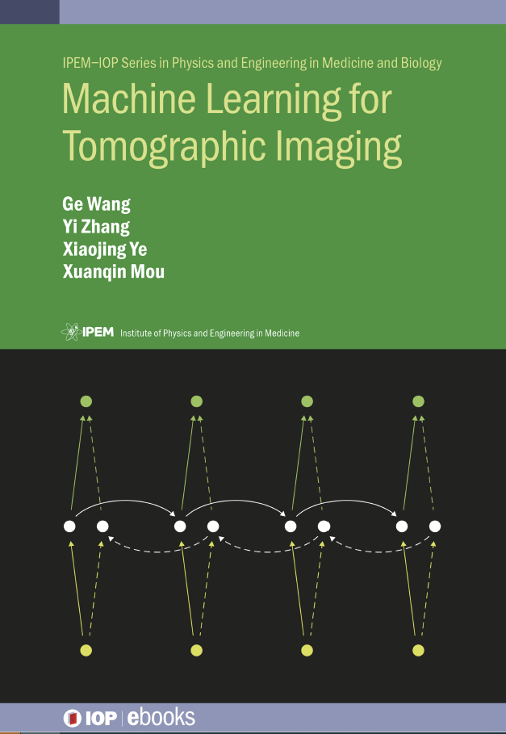
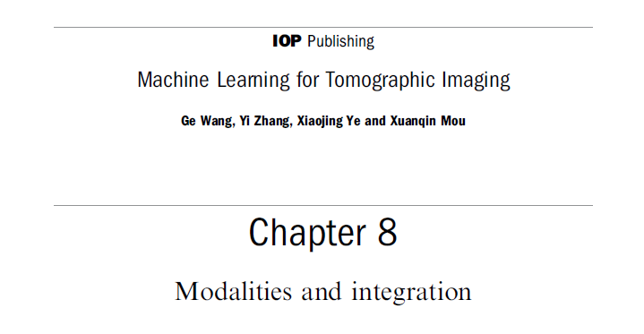
Green Book Chapter 8

Slide 20
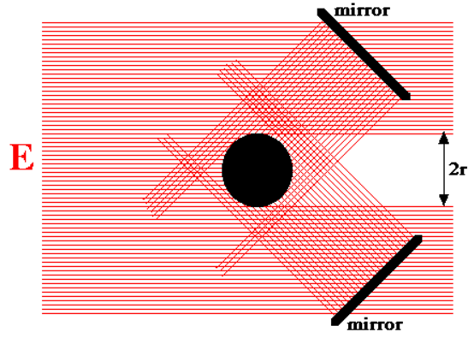
Key Definitions Made Clear
We can first think the normal of dA parallel to the direction of interest, and then dA can be rotated with a cosine correction to find the projected cross-section/area.
In the context, radiances along various directions do not interfere. Fluence rate gives the absorbed power in the volumetric element.

Slide 21
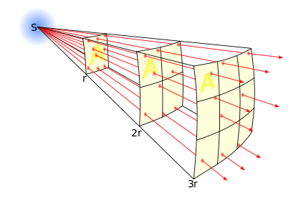
Further Explanation
Radiance is flux (through an area) emitted from a source distribution which can be decomposed into point sources. Intensity of a point source is normalized with respect to area, angle, and time, and taking the limit.

Slide 22
RTE Made Easy
Energy density change must be explained by source (emission), divergence (propagation/geometrical), scattering (interaction), and absorption (heat)

Slide 23
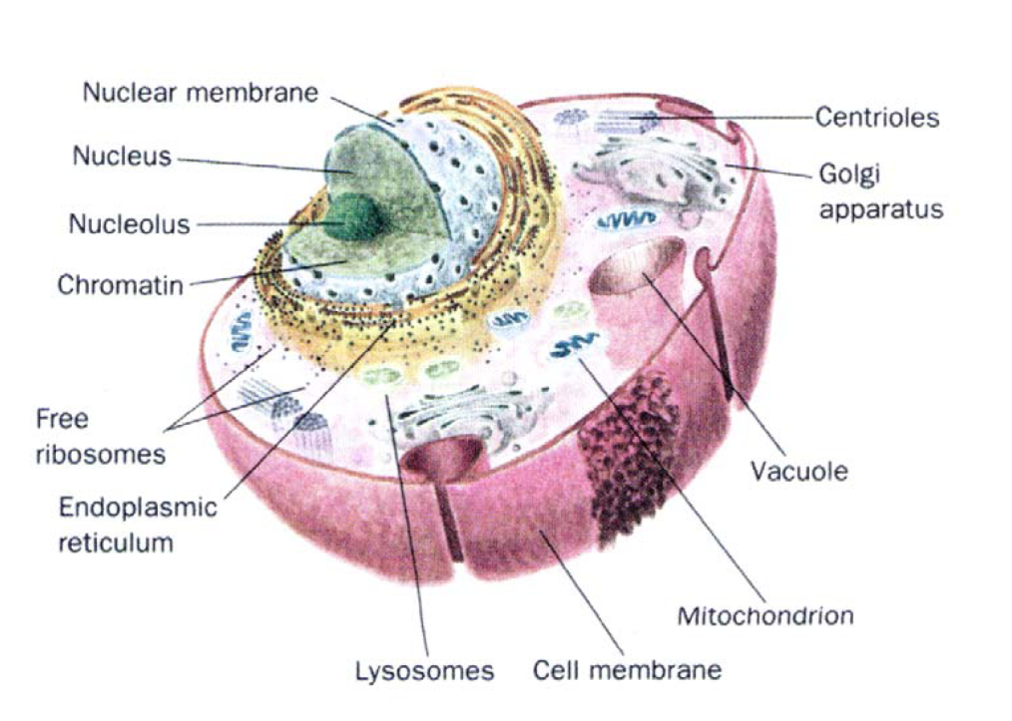
Scattering in Tissue
Cell Structure
10-30 μm
(1 μm = 10⁻⁶ m)

Slide 24
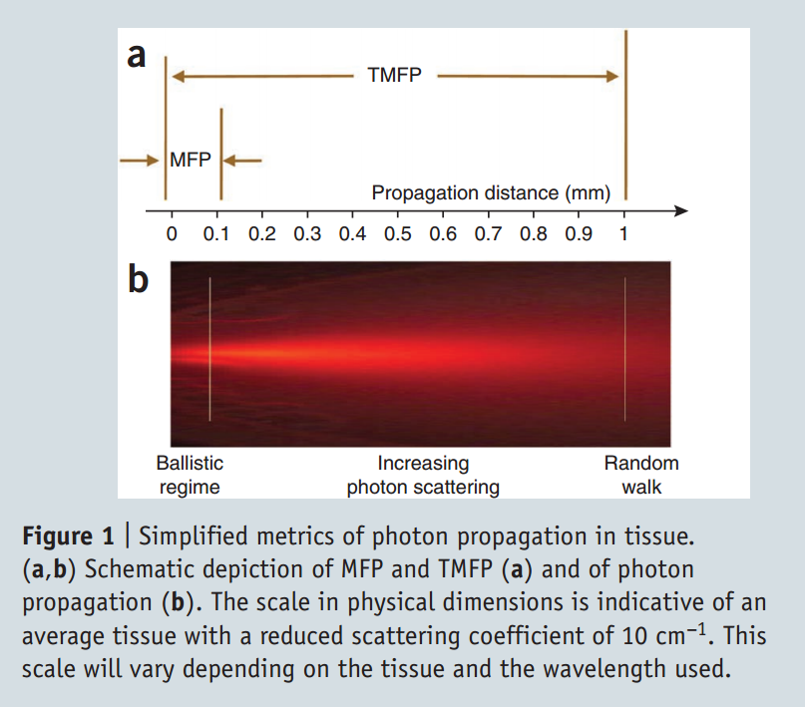
MFP & TMFP
Mean Free Path (MFP):
Average path length before an event (absorption / scattering)
Transport Mean Free Path (TMFP):
Average distance a photon moves in its original direction after an infinite number of scattering collisions
http://www.nature.com/nmeth/journal/v7/n8/pdf/nmeth.1483.pdf

Slide 25
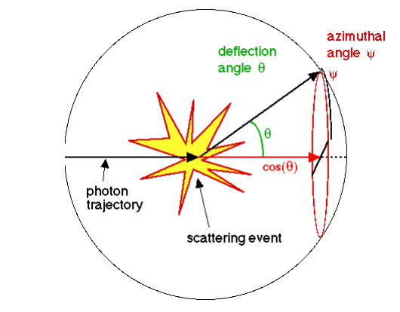
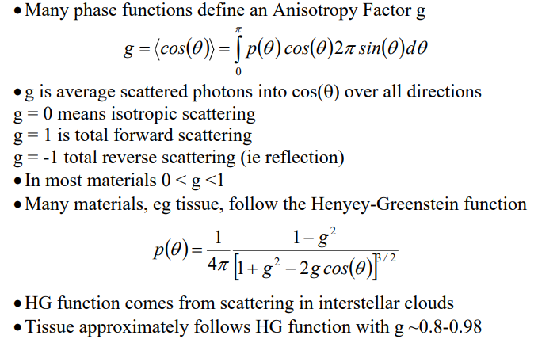
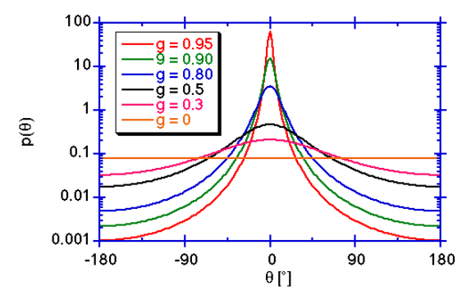
Henyey-Greenstein Phase Function
Probability
Solid Angular Span
http://www2.ensc.sfu.ca/~glennc/e376/e376l7.pdf

Slide 26
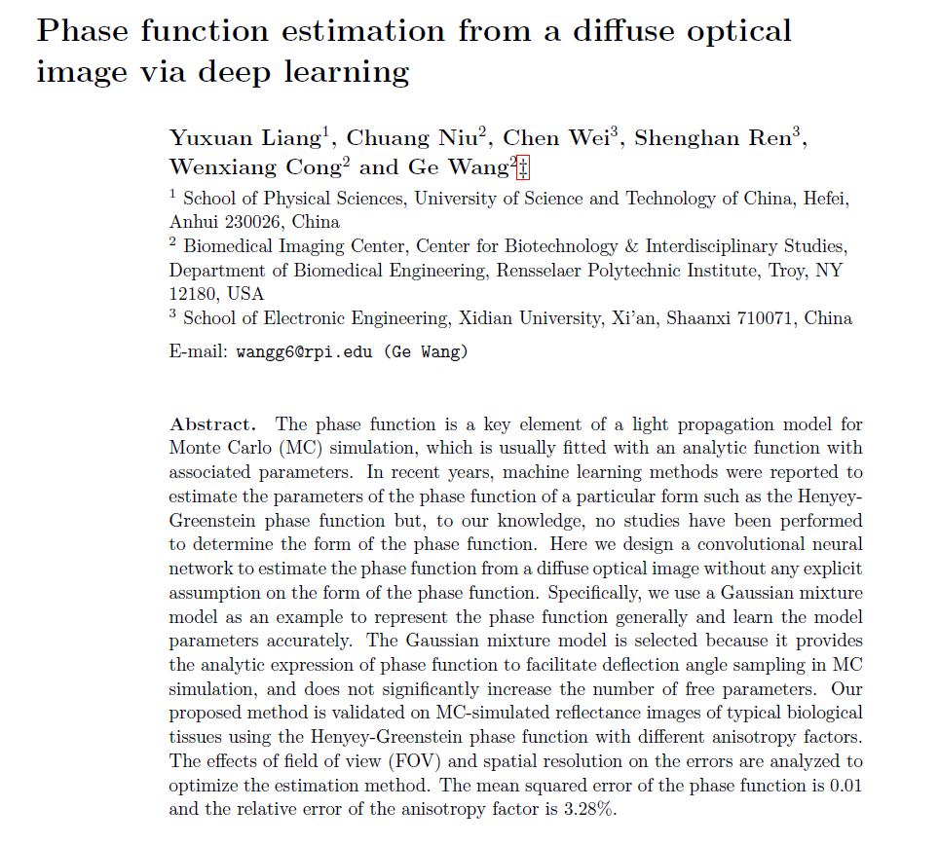
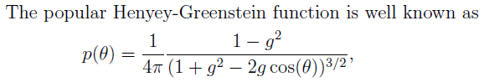
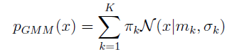

Slide 27
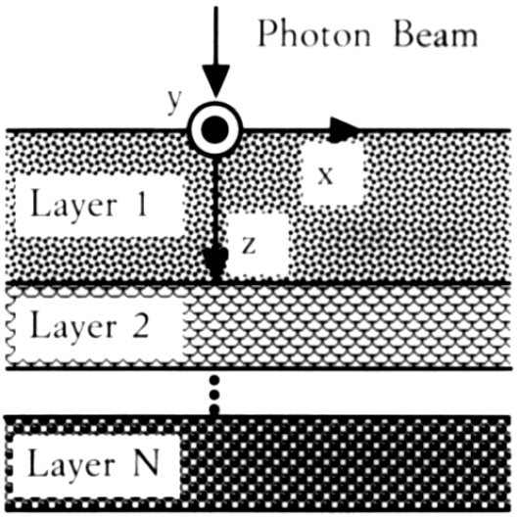
Multi-layered Tissue Model
LH Wang, et al. MCML - Monte-Carlo modeling of light transport in multilayered tissues. Computer methods and programs In biomedicine, 47 (2): 131-146, 1995

Slide 28
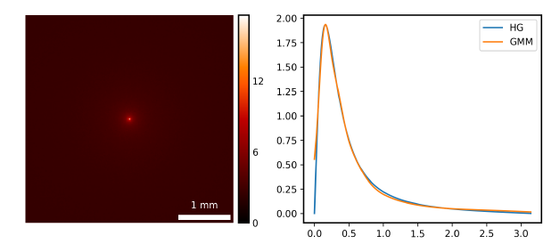
Typical Phase Function Data

Slide 29
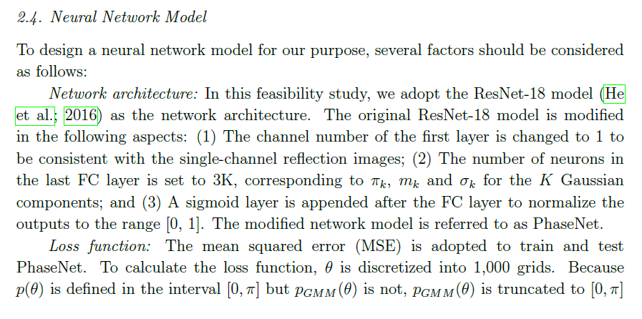
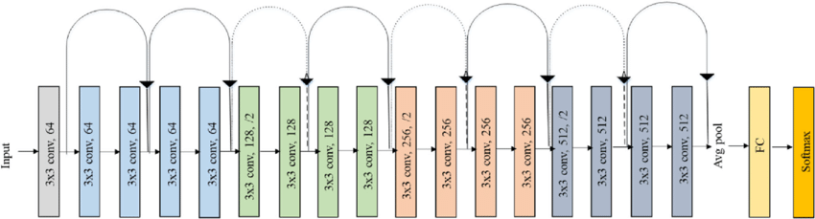

Slide 30
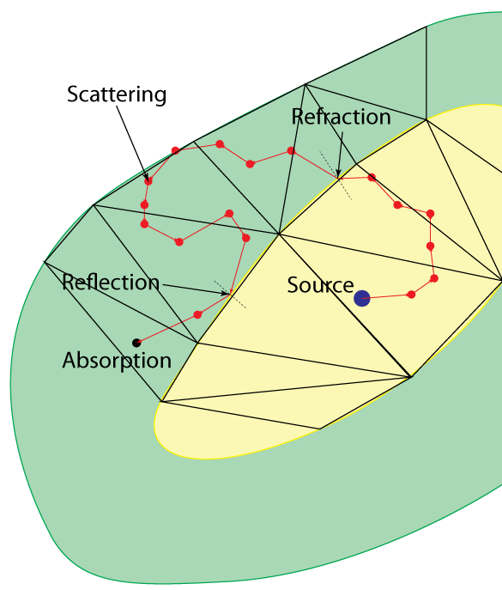
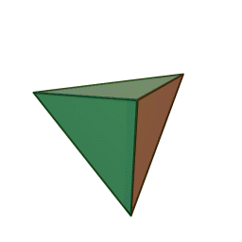
Tetrahedron-based MC simulation
Mean free path of a photon in tissue is small (<0.1mm)
A mesh with simpler shape shall be more efficient for the photon-mesh intersection test
Tetrahedron: Simple yet flexible building block

Slide 31
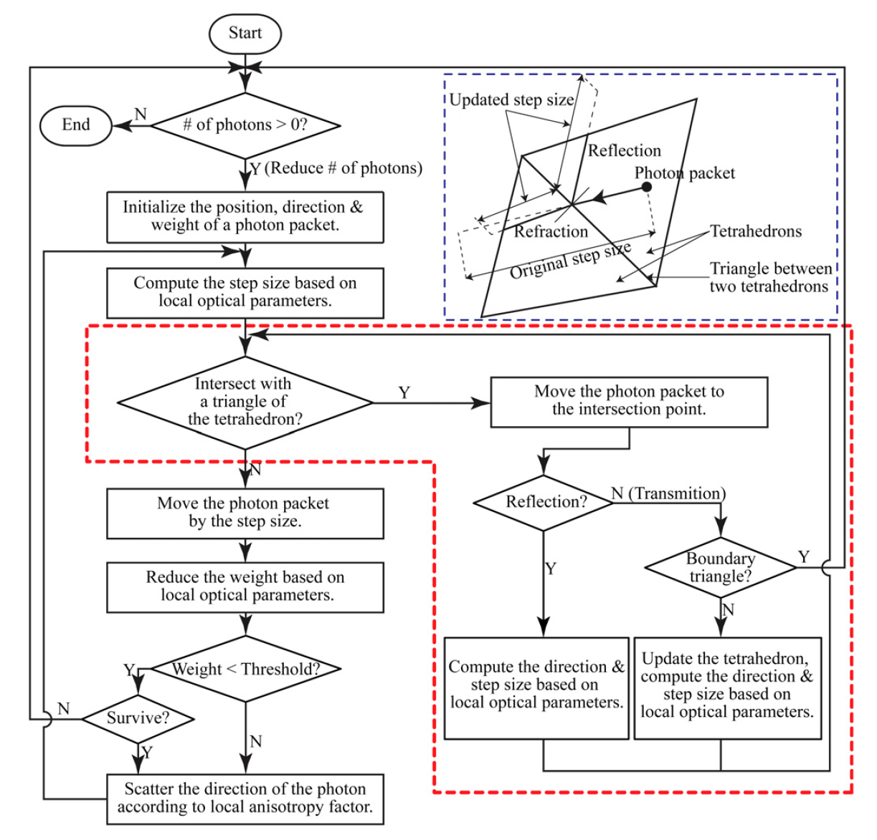
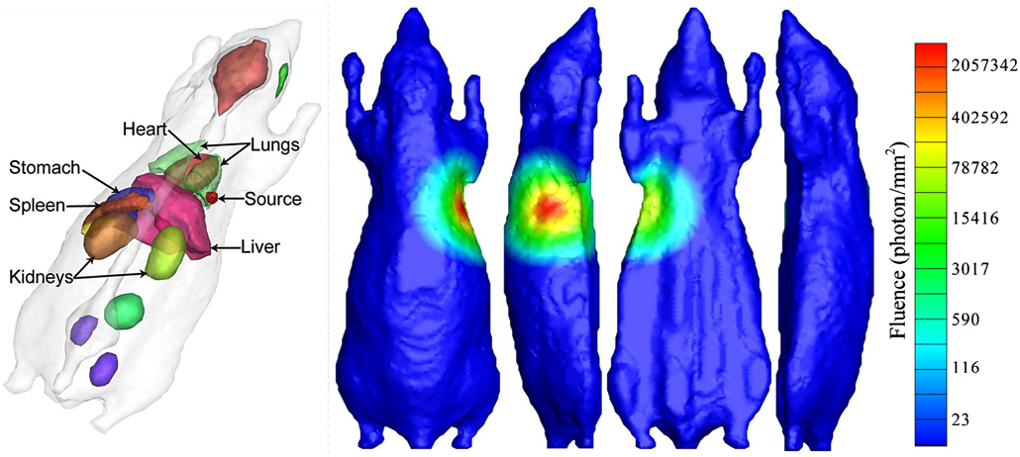
Monte-Carlo Simulator
Shen HO, Wang G: A tetrahedron-based inhomogeneous Monte Carlo optical simulator. Phys. Med. Biol. 55:947, 2010

Slide 32
Homework
Describe the OCT principle & the RTE derivation
In the background there are four light-emitting pixels with intensities a, b, c and d respectively. You have a single pixel camera with an adjustable field of view. Mode 1: Image each pixel with 10 exposures, each lasting 1 second. That is, you have 10 readings for each pixel. Mode 2: The same as the first mode but in each exposure you cover two pixels (hence, about twice as many photons as that you get in Mode 1. Which mode gives you a better estimation of a, b, c, and d?
a
b
a
b
c
d
c
d

